Slide 1
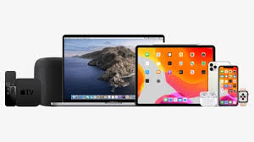
Project Title: Crafting Compelling Web Presences
PRESENTED BY AARTHI
BATCH CODE : GUVIMBE4
WEBSITE CHOSEN: APPLE

Slide 2
iPhone
APPLE’S PRODUCT AND SERVICES: DESCRIPTION
Experience cutting-edge technology with the iPhone. Combining sleek design, powerful performance, and a user-friendly interface, the iPhone redefines the smartphone experience.
MACBOOK
Unleash your creativity with the MacBook. Featuring stunning Retina displays, fast processors, and a seamless macOS experience, it's the perfect companion for work and play.

Slide 3
IPAD
Immerse yourself in the world of creativity with the iPad. With a stunning display, powerful performance, and a wide range of apps, it's your go-to device for productivity and entertainment.
APPLE WATCH
Stay connected and motivated with the Apple Watch. Track your fitness, receive notifications, and enjoy convenient features on your wrist, making it the ultimate smartwatch.

Slide 4

Website is developed by:
Maps
Apple Mapkit JS
ANALYTICS
Adobe analytics
SECURITY
HSTS
PERSONALISATION
Adobe target
ADVERTISING
Google ads
MISCELLANEOUS
Open graph
A/B TESTING
Adobe target
JAVASCRIPT LIBRARIES
Preact

Slide 5


Website Responsive Design and Mobile Optimization
Store Page
Galaxy S9 Note 8= 360x740 (Responsive is good)
iPhone 8 Plus, 7 Plus, 6S Plus=414x736 (Responsive is good)
I pad mini = 1440x900 (Responsive s good)
Laptop = 1440x900(Responsive is good)
Laptop = 1280x800 (Responsive is good)
2. Support Page:
I phone 6 = 375x667 (Responsive is good)
Galaxy note 8 = 360x740 (Responsive is good)
I pad = 768x1024 (not suggested and can be improved)
Laptop = 1440x900 (Responsive is good)
Laptop = 1280x800 (Responsive is good)

Slide 6
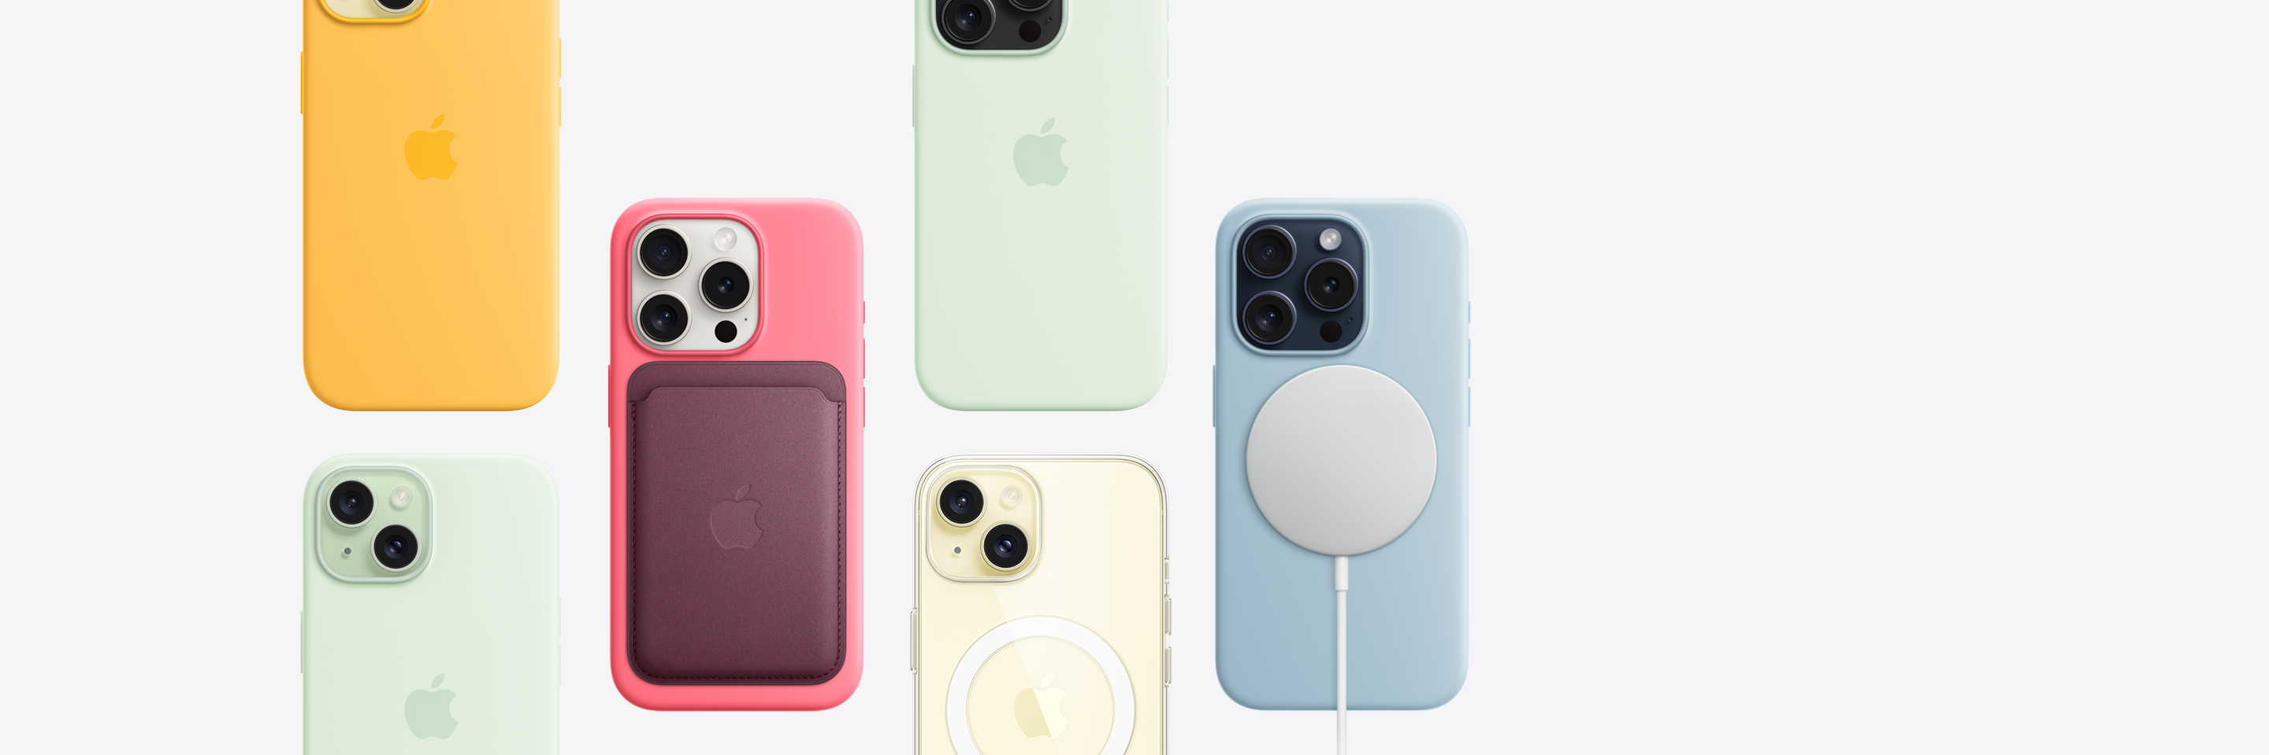
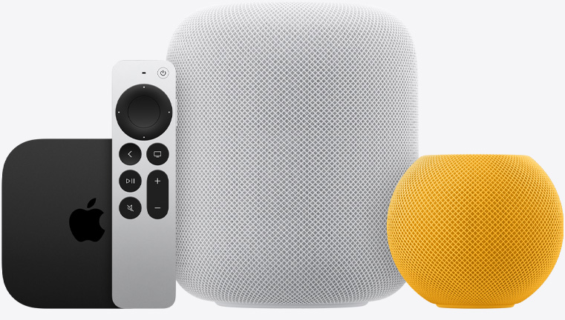
3.Entertainment Page
I phone 8 = 414x896 (Responsive is good)
Galaxy Plus = 412x846(Responsive is good)
I pad Pro = 1024x1366(Responsive is good)
Laptop = 1422x900(Responsive is good)
4.Accessories
I phone 7= 414x736 (Responsive is good)
I pad mini = 768x1024 (Responsive is good)
Laptop = 1440x900 (Responsive is good)
Laptop = 1280x800 (Responsive is good)
5. Tv and Home Page
Galaxy S9 Note 8= 360x740 (Responsive is good)
I Phone 8 Plus, 7 Plus=414x736(Responsive is good)
I pad mini = 1440x900 (Responsive is good)
Laptop = 1440x900(Responsive is good)
Laptop = 1280x800 (Responsive is good)

Slide 7
Apple's Website Mistakes
OBSERVATION
Large Media Files: High-resolution images and videos may lead to slower load times.
Limited Customization Options: Some users might prefer more customization features.
Depth of Content Navigation: The depth of navigation might be challenging for users seeking detailed information.
Lack of Interactivity: While informative, the website might benefit from more interactive elements.
Accessibility Features: Continuous enhancement of accessibility features is important.

Slide 8
Suggested Improvements:
1. Optimize media files for faster loading without compromising quality.
2. Explore providing users with additional customization features for layout or theme.
3. Enhance navigation cues or provide more direct pathways to in-depth content.
4. Consider adding interactive features or tools for a more engaging user experience.
5. Continue enhancing accessibility features for an inclusive user experience

Slide 9
Best Practices for Creating visually appealing and User friendly Website Design
1. Responsive Design
Responsive design ensures that your website adapts seamlessly to different devices and screen sizes, providing an optimal viewing experience for users on desktops, tablets, and smartphones. This helps in retaining functionality and visual appeal across a diverse range of devices.
2. Clear Call-to-Action (CTA):
A clear call-to-action guides users on the desired path, whether it's making a purchase, signing up for a newsletter, or exploring further. Make CTAs visually prominent, using compelling language to encourage user interaction.
3. Readable Typography:
Legible and well-chosen typography enhances the readability of your content. Choose the fonts that are easy on the eyes and maintain consistent font sizes for a comfortable reading experience, both on desktop and mobile devices.

Slide 10
4. High-Quality Images and Graphics:
Visual elements contribute significantly to a website's appeal. Use high-resolution images and graphics to create a visually appealing design. Ensure that visuals are relevant, optimized for web use, and contribute to the overall user experience.
5. Accessible Design:
An accessible design ensures that your website can be used by people of all abilities. Consider factors such as providing alternative text for images, using proper heading structures, and ensuring keyboard navigation to make your site usable for everyone.
6. Hierarchy of Information:
Establish a clear hierarchy of information to guide users through the content. Prioritize key information, use headings and subheadings to organize content, and maintain a logical flow. This helps users quickly understand the structure and importance of different elements on your pages.

Slide 11
Landing Page Link
https://www.figma.com/proto/N6GwCcuSom4lRfOgWAKWyv/Apple-Landing-Page?type=design&node-id=1-2&t=YdWM9kMpKsqGbBSQ-1&scaling=min-zoom&page-id=0%3A1&mode=design

